Slide 1
Geog 360 Human Geography
Dr. Christy Jocoy
IMPORTANT ANNOUNCEMENT: If you had trouble finding the NRC book chapter or the article in The Professional Geographer assigned for today, I will be conducting a workshop on this at the end of class today.

Slide 2
Learning objectives
Describe a geographic approach/perspectives
Define human geography
Provide examples of what human geographers study
Describe the subareas or subdisciplines of human geography
Explain & provide examples of human geographic concepts

Slide 3
1. Describe a geographic approach
Attention to spatial patterns
human-environment dynamics
uniqueness of place
connections between regions and across scales

Slide 4
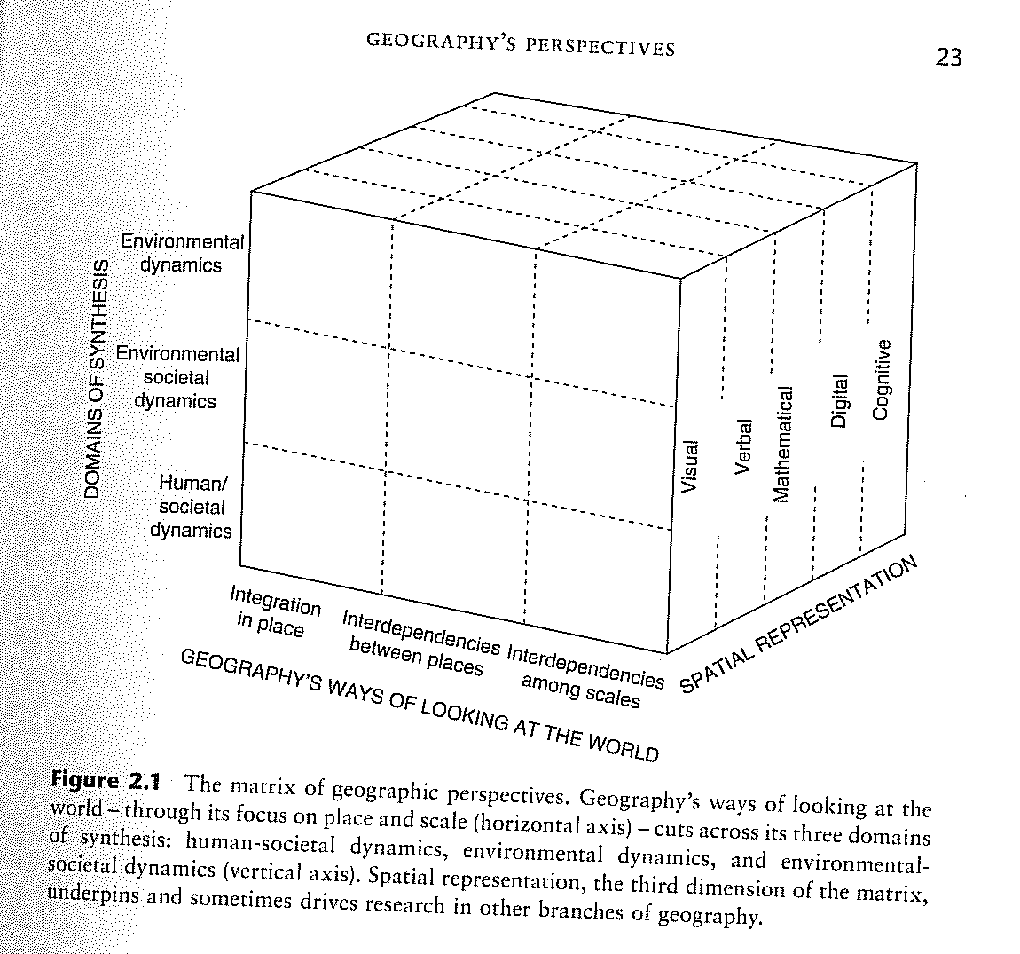
1. Geography’s perspectives (NRC report)

Slide 5
2. Human Geography
Def. - study of locational patterns and dynamics of human activity
Patterns – arrangement of objects in space –where?
Dynamics – concern with processes - why and how did it get there?
Def. - the study of the spatial organization of human activity and of people’s relationship to their environment.
Why?
Make location decisions
Understand a place

Slide 6
3. Examples of geographic inquiry
Location analysis – why a phenomenon or behavior is located where it is found.
Navigation/Mobility - how mental maps influence people’s movement.
Identity and location - how race or gender affects how people interact with and are impacted by their location in urban or rural spaces.

Slide 7
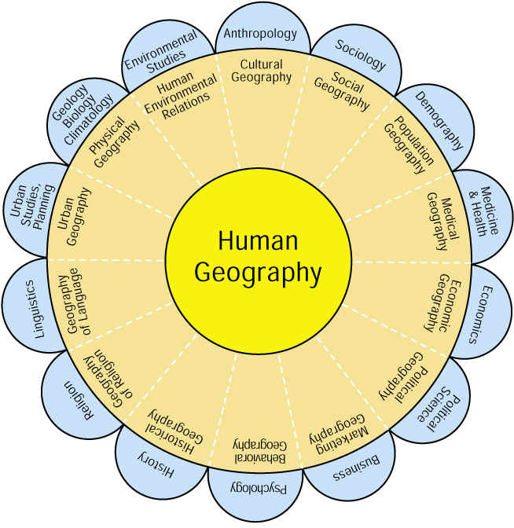
4. Subareas of Human Geography

Slide 8
5. Human Geographic Concepts
: an idea of what something is or how it works
Full Definition of CONCEPT
something conceived in the mind : thought, notion
an abstract or generic idea generalized from particular instances
Merriam-Webster’s online
http://www.merriam-webster.com/dictionary/concept

Slide 9
Distribution
– arrangement of phenomena on or near Earth’s surface
ex: Major league baseball teams
Concept for describing a Pattern
Density – frequency within a space – person per sq mi
Concentration – extent of feature’s spread over space
Distance decay – tapering off of a process, pattern or event with increasing distance.

Slide 10
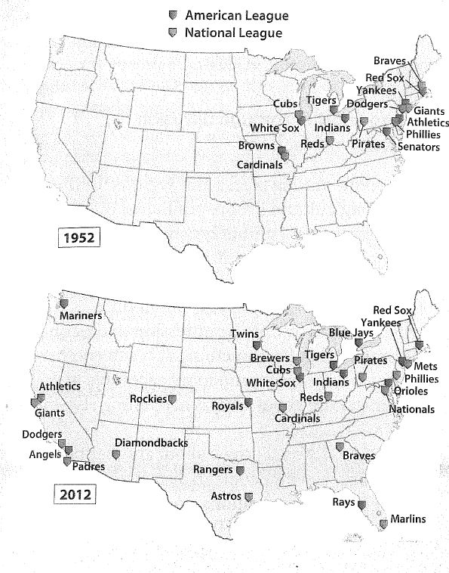

Slide 11
Spatial variation
difference in distributions of a phenomenon from one place or region to another
Spatial association
degree to which two or more phenomena share similar distributions

Slide 12
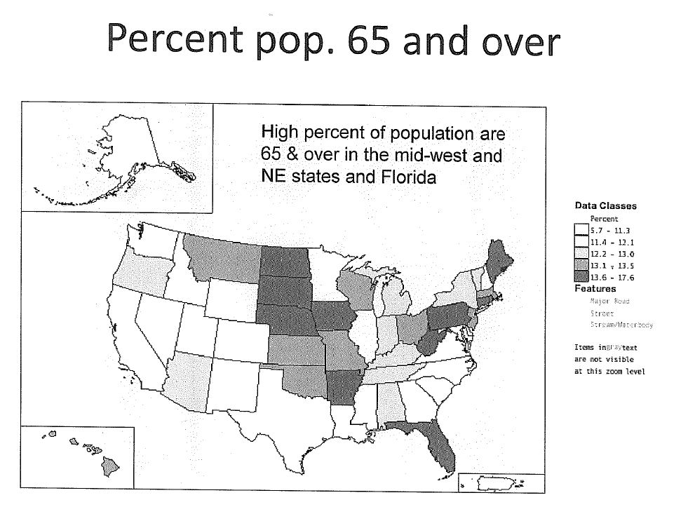

Slide 13
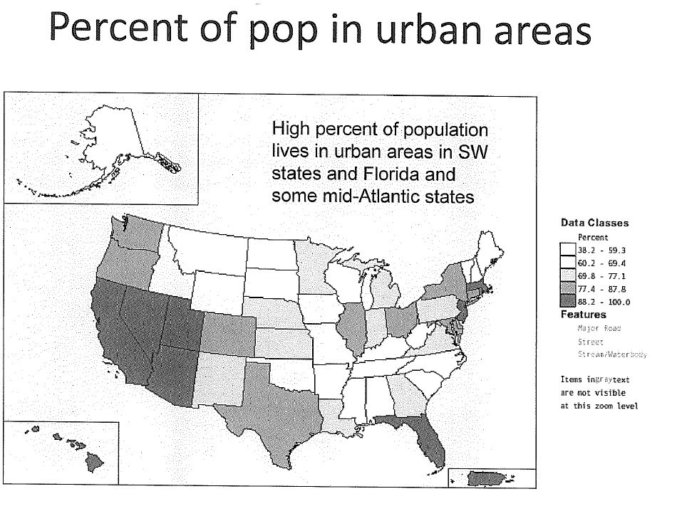

Slide 14
Spatial diffusion
movement of a phenomenon, such as an innovation, information or an epidemic across space and over time.
4 types:
Relocation - migration
Contagious – person to person, ex: H1N1 – contagious and relocation or contagious and hierarchical
Hierarchical – top-down or rank-order manner
Stimulus – spread of an idea – grocery stores having cafes in them; organic food; local produce.

Slide 15
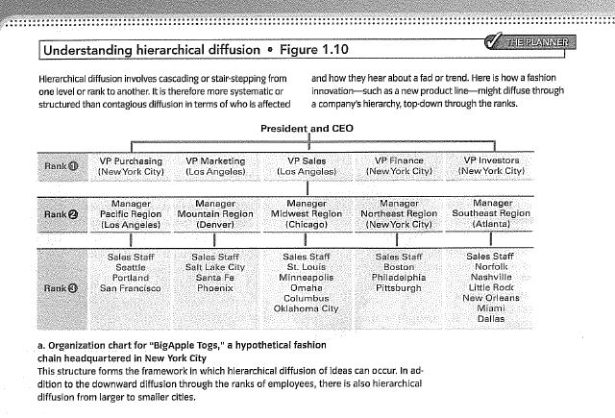
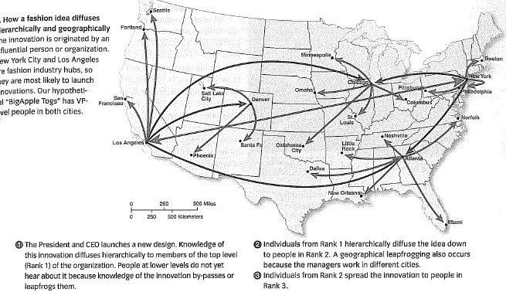

Slide 16
Spatial interaction
connections and relations that develop among places and regions as a result of movement or flow of people, goods, or information
Affect by
accessibility –ease of reaching a particular place (Friction of distance)
Connectivity – number and kind of linkages between places

Slide 17
Learning objectives
Describe a geographic approach/perspectives
Define human geography
Provide examples of what human geographers study
Describe the subareas or subdisciplines of human geography
Explain & provide examples of human geographic concepts

